Slide 1
Scrum Artifacts and events week4
Universidad para la Cooperación Internacional

Slide 2
Product Backlog
Ordered list of desired functionality
Visible to all stakeholders
Any stakeholder (including the team) can add items
Constantly re-prioritized by the Product Owner
Top Items are more granular than Bottoms
Held during the Backlog Refinement meeting
Specify the what rather than the how of a customer-centric feature
Often written in the form of a User Story
Has a definition of "finished" that encompasses the entire product to avoid technical debt
May have item-specific acceptance criteria
Effort is calculated by the team, preferably in relative units (for example, story points)
The effort is about 2-3 people 2-3 days, or less for more advanced equipment

Slide 3
Moscow
Notes:
2 min charlie

Slide 4
7 Product Dimensions

Slide 5
How to create a User story

Slide 7
Definition of ready

Slide 9
Definition of Done

Slide 10
Definition of Done (DoD)
Everything that converts a Backlog Item (PBIs) into an incremental product
Done = delivery to the customer
Acceptance criteria managed by the PO and defined by customers and users

Slide 11
Acceptance criteria Examples
Defined coding standards (like identified in tools – FxCop etc)
Test- Driven Development
Unit Test Coverage
Maintainability Index
No Defects/Known Defects
Technical Debt
Design Principles etc.
Availability
Maintainability
Performance
Reliability
Scalability
Security
Usability
Compliance/Regulatory
Legal

Slide 12
Example

Slide 13
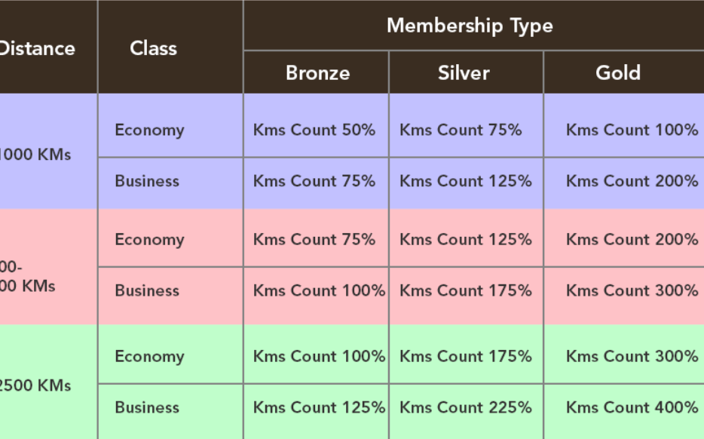
Examples

Slide 15
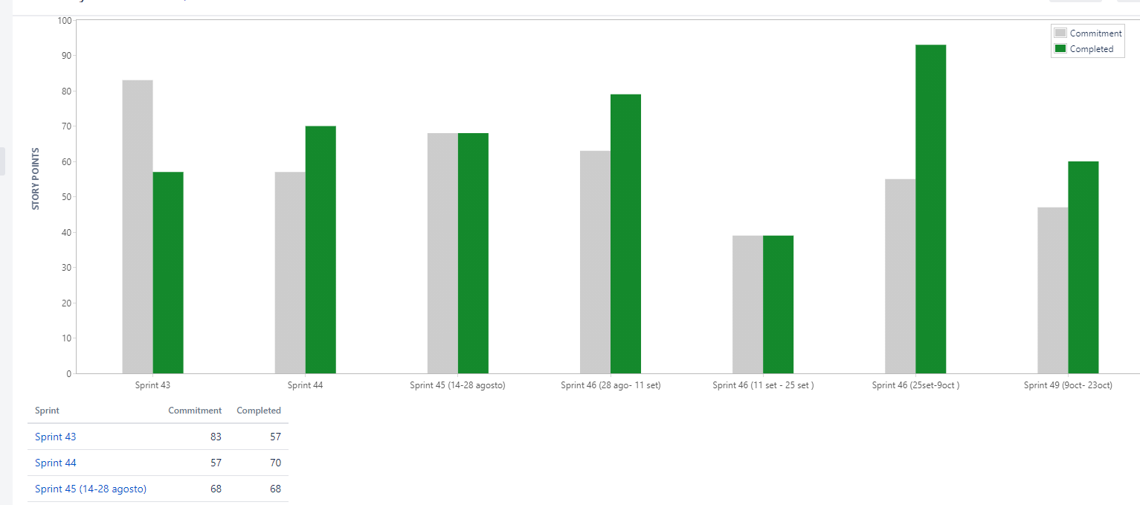
Velocity Chart

Slide 16
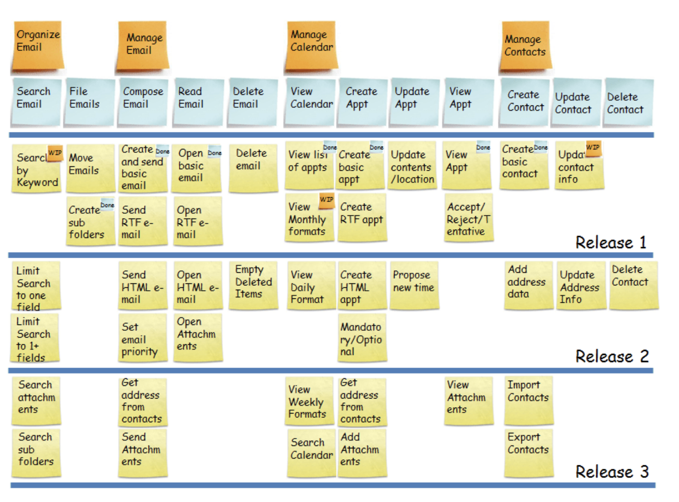

Slide 17
Sprint Backlog

Slide 18
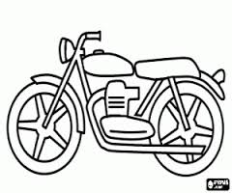
Increment
Vertical increments

Slide 19
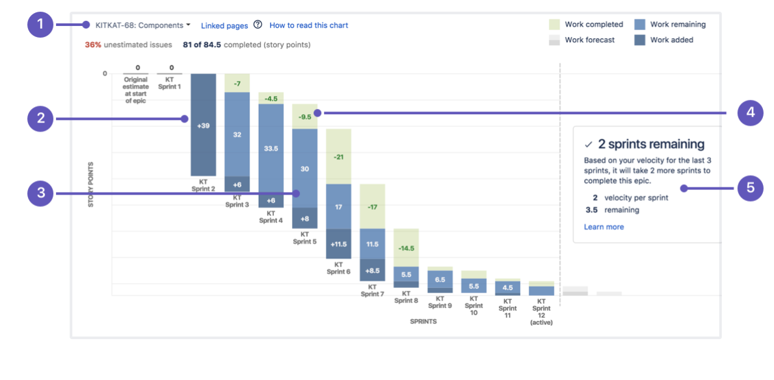
Burndown Chart
Notes:
https://quizizz.com/admin/quiz/5d91d600675aa9001ae47aba

Slide 20
Velocity Chart

Slide 21
Professor Carlos Castro Torres
ccastro@uci.ac.cr

