Slide 1
Introduction to Agile Week1
Universidad para la Cooperación Internacional

Slide 2
History of agility
2001 Several different framework experts (Lean, Scrum) gather and form the Agile Manifesto as the answer to improving the project development process. In the following years, more framework creators joined and formed what we know today as Agility. They concluded that agility is a philosophy that allows focusing on the objective, optimization of means and the elimination of waste.

Slide 3
4 Project life cycles:
Life Cycle
Requirements
Deliveries
Purpose
Predictive
They can be identified in the early stages of the project
Single delivery
Execute the project within the established time and costs.
Iterative
Single delivery
Approach the scope of the solution to be developed.
Dynamic
Incremental
Dynamic
Small and frequent deliveries
Deliver value to the business early
Agile
Dynamic
Small and frequent deliveries
Adding value to the business through frequent deliveries that incorporate learnings

Slide 4
4 Project life cycles:
Predictive
Agile
^{Stable Resources}
Stable Schedule
^{Fixed requirements}
Value-driven
Driven by a plan
^{Estimated resources}
Estimated Timeline
^{Estimated characteristics}
Are we delivering the project on time and on budget?
^{and budget?}
Are we delivering the right product, at the right time, within the expected profitability?

Slide 5
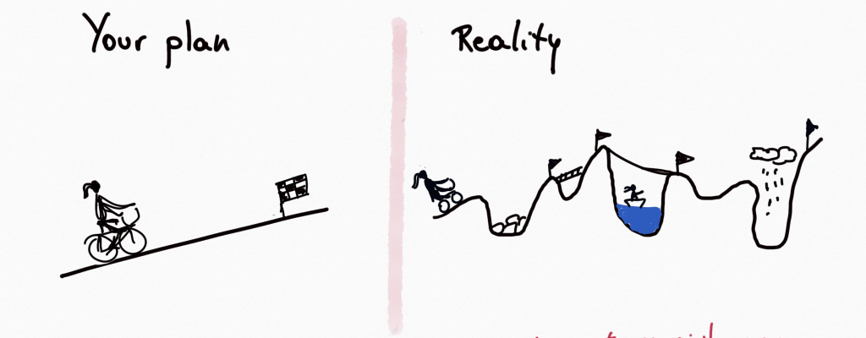
Ágile is in your mind

Slide 6
Principios de la Agilidad
Customer Centric
1
Regular Reflection and Adjustment
12
2
Embrace Change
Early and Continuous Delivery of Valuable Software
Self-Organizing Teams
11
3
Agile Principles
Technical Excellence
10
4
Business and Developers Together
Frequent Delivery
9
5
Motivated Individuals
8
6
Face-to-Face Conversation
Working Software
7
Simplicity
Notes:
2 Palabra clave ventaja competitiva
3. Acortar los tiempos
4. Asegurarse de tener toda la gente que se necesita
5. Motivación –Recursos necesarios
6. Real Time
7.
8. Resultados sostenidos en el tiempo
10 a 15 minutos

Slide 7
Cynefin Framework

Slide 9
Agile is …
+
Collaboration
+
Deliveries
-
Bureaucracy
Agile
+
Business Value
+
Adaptabiliy

Slide 10
Agile Framework

Slide 11
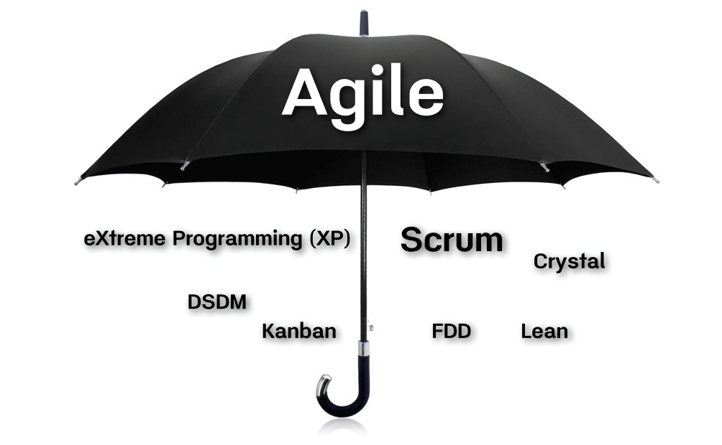

Slide 13
Plan
Reality

Slide 14
Cost
Value
Risk

Slide 15
Characteristics and functions of a system
Fuente: Standish Group study reported at XP 2002

Slide 16
Premises :
The client knows what he wants
Developers know how to do it
Nothing will change along the way

Slide 17
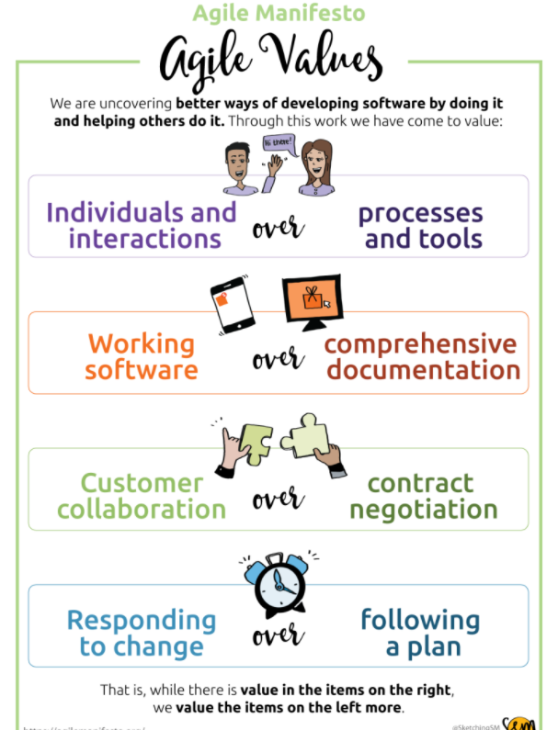
Agile Manifesto

Slide 18
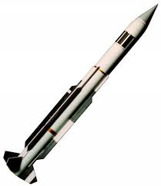
Premises :
The client discovers what he wants
Developers discover how to do it
There are changes on the way

Slide 19
Not trying to define everything right from the start
Don't do it all at the same time
Cost
Cost
Value
Risk
Value

Slide 20
Horizontal Increments
Vertical Increments

Slide 21
Myths related to agile processes
Goal
Caos
Risk
Agile ≠ Faster
Undisciplined No deadlines or indicators
Without management or in the traditional process
Agile ≈ Simple
Constant Monitoring
In continuous management
Scale
Short
Fashion
Small projects / processes only
No documented processes
It is another of many fashions
Projects of any size
A different way to document
A philosophy

Slide 22
Major steps required to successfully plan and execute an agile software project
Set your project vision and scope
Build out your product roadmap
Select Your Agile Framework
Define your team

Slide 23
Professor Carlos Castro Torres
ccasto2512@gmail.com

