Slide 1
Master in Project Management
Planning and Strategic Analysis of the Company
Presentation – Week 3: Strategic Assurance ( PMO )

Slide 2
Organizational maturity in Project Management
How to produce good results, in a repeatable way in project management, and its alignment with the achievement of strategic goals?

Slide 3
Critical factors of success
They are defined as those business elements that are understandable and measurable with such strategic value that they have to be executed correctly for the organization to be successful.
These are aspects considered the most conducive to achieving success.
Sector
strategic competitiveness
Environment
temporary
Management

Slide 4
Critical factors of success
They are elements in the organization on which it is necessary to act to achieve favorable results with respect to the goals set.

Slide 5
Project management maturity
In project management, the maturity level is the degree to which an organization:
develop
assimilate
implements
Good practices in project, program and portfolio management.

Slide 6
Project management maturity
Maturity is related to the capacities to:
produce good results.
repeatable in project management, and
Its alignment with the achievement of strategic goals.

Slide 7
Project management maturity
maturity models
A maturity model is a structured set of good practices, measurement tools and analysis criteria, among others.
That allow evaluating the capacities of the organization's processes, with respect to the best practices of the industry in a certain field.

Slide 8
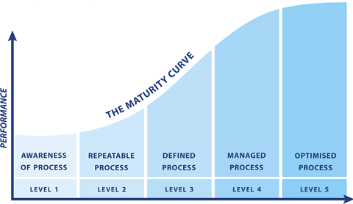
Project management maturity
Maturity models differ in the concepts they incorporate and the suggestions they make about what the maturity curve should look like.
Each model identifies incremental levels that indicate the organizational improvement plan.

Slide 9
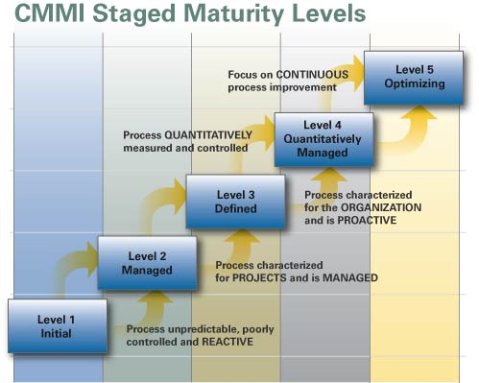
Project management maturity
For each level, the structured processes (capabilities) that an organization should have are identified.
The diagnosis facilitates the identification of strengths and weaknesses with respect to the process areas.

Slide 10
Project management maturity
Each model uses its own instruments or questionnaires to diagnose the level of maturity.
For the application of the instruments, it is critical to select people linked to the field of projects.
Wrong or biased answers can lead to diagnoses that are far from reality.

Slide 11
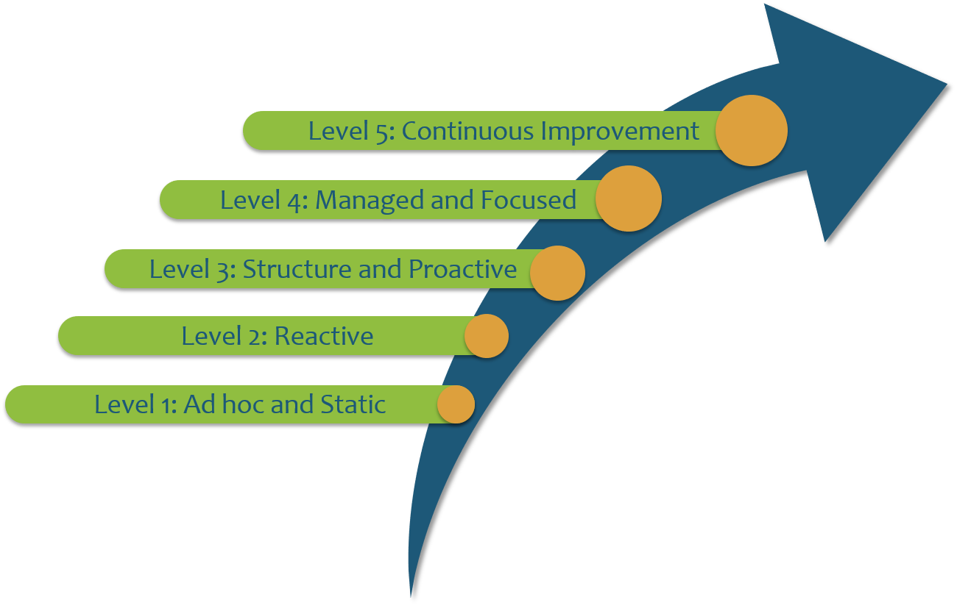
Project management maturity
They make it possible to identify determinant levels of organizational behavior for the formulation of an organizational development plan.
They facilitate the identification of strengths and weaknesses with respect to the process areas.

Slide 12
Project management maturity
Some of the best known models are:
Kerzner Project Management Maturity Model .
PMI
P3M3 Model - Portfolio, Program and Project Management Maturity Model.
Berkeley PM2 Model (Process Maturity in Project Management)
PMMMSM - PM Solutions Project Management Maturity Model .
PRINCE 2 model
Model by Erling S. Anderson & Svein Arne Jessen

Slide 13
The Kerzner Model - KPM3
It was developed by the American engineer and project management consultant Harold Kerzner .
Dr. Kerzner developed the model over seven years based on extensive studies conducted at major companies around the world.
The KPM3 TM model is based on the CMM ® and is aligned with the PMBOK ® Guide.
It is based on a questionnaire that measures the organizational maturity of project management on a five-level scale.
PMBOK is a registered mark of the Project Management Institute, Inc.

Slide 14
The Kerzner Model - KPM3
Level 1
Project Management is of personal interest rather than corporate.
Standard terminology is incorporated.
There is practically no support at the management level.
There is no clarity about the benefits of professional Project Management.
There is no investment in training or education in Project Management.
5. Continuous improvement
4. Benchmarking
3. Unique methodology
2. Common processes
1. Common language

Slide 15
The Kerzner Model - KPM3
Level 2
Recognition of the need for standardized processes that can be repeated.
Need for cost control
Particular processes are incorporated
The benefits of Project Management are recognized.
Organizational support at all levels
Development of a training program.
5. Continuous improvement
4. Benchmarking
3. Unique methodology
2. Common processes
1. Common language

Slide 16
The Kerzner Model - KPM3
Level 3
integrated processes
culture support
Management support at all levels
Standardized methodology for Project Management
Return On Investment (ROI) in Project Management training is recognized quantitatively and qualitatively
Improvements due to Project Management are recognized.
5. Continuous improvement
4. Benchmarking
3. Unique methodology
2. Common processes
1. Common language

Slide 17
The Kerzner Model - KPM3
Level 4
There is a project office ( PMO ) or a center of excellence
Process optimization to generate competitive advantages.
Benchmarking with similar and different industries
Quantitative benchmarking in processes and methodologies
Qualitative benchmarking in the application of Project Management
5. Continuous improvement
4. Benchmarking
3. Unique methodology
2. Common processes
1. Common language

Slide 18
The Kerzner Model - KPM3
level 5
The results are used to optimize methodologies.
Record of lessons learned
knowledge transfer
Coaching program through the PMO
Strategic planning for the Project Management.
5. Continuous improvement
4. Benchmarking
3. Unique methodology
2. Common processes
1. Common language

Slide 19
Master in Project Management
Planning and Strategic Analysis of the Company
Presentation – Week 3: Strategic Assurance ( PMO )

