Slide 1
Master in Project Management
Planning and Strategic Analysis of the Company
Presentation – Week 3: Strategic Assurance ( PMO )

Slide 2
What is a Project Management Office?
The PMO is the natural link between the organization's portfolios, programs and projects and corporate performance measurement systems.

Slide 3
Government, Governance and Governance
Government
Governance
Governance
Governance quality.
Art or way of governing that aims to achieve lasting economic, social and institutional development, promoting a healthy balance between the State, civil society and the economic market.
Command with authority or govern something / Direct a country or a political community / Guide and direct / Manage someone, exert a strong influence on him.

Slide 4
Governance
Governance
It specifies the rules and procedures for decision-making in corporate matters.
It provides the structure through which companies define and achieve their objectives, while reflecting the context of the social, regulatory and market environment.
It is a mechanism for monitoring the actions, policies and decisions of companies. Governance encompasses the alignment of interests among stakeholders.

Slide 5
Governance
Responsibility for maintaining proper governance of a project is usually attached to the project's lead sponsor or project steering committee.
Among other aspects, project governance should include elements such as:
Definition of the management structure
Policies, processes and methodologies
Limits of authority for decision making
Responsibility and accountability
information interactions
Elevation of critical issues or risks

Slide 6
Project governance
Governance of Project Management ( GoGP )
Organization
These are those areas of corporate governance that are specifically related to project management activities.
Corporate Governance
GoGP
Project Management

Slide 7
WHAT IS A PMO?

Slide 8
What is a PMO ?
It is a management structure that standardizes project-related governance processes and makes it easier to share:
Means
Methodologies
Tools
Techniques
Responsibilities may range from providing project management support functions to being responsible for managing one or more projects.

Slide 9
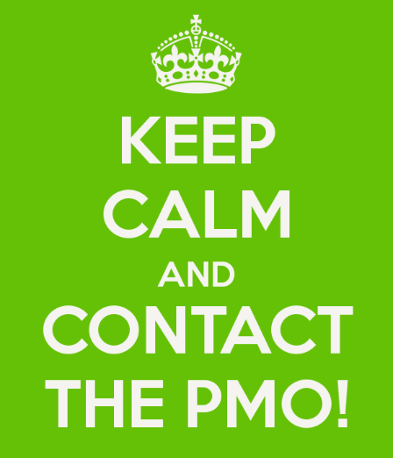
What is a PMO ?
The PMO integrates data and information from corporate strategic projects and assesses the extent to which high-level objectives are being met.
The PMO is the natural link between the organization's portfolios, programs and projects and corporate performance measurement systems.

Slide 10
What is a PMO ?
The specific form, function and structure of a PMO depends on the needs of the organization it supports.
The projects that the PMO supports or directs may not be related to each other other than to be jointly managed.

Slide 11
Benefits of PMOs
Identify gaps in the achievement of strategic objectives
Escalate current risks and identify potential risks early
Ensure adequate communications to relevant stakeholders
Improve monitoring and control of projects
Mediate problem solving
Increase the efficiency of project monitoring
It provides objective criteria in the evaluation of projects, programs and in the formation of the strategy.

Slide 12
Importance of PMOs
It is basically the standard bearer of the project management culture in an organization.
Centralizes the information of the organization's projects and reports it in a consolidated manner
“Coordinate” the projects in different ways
Serves as custodian of project management organizational knowledge
Serves as a bridge between strategic planning and strategy implementation

Slide 13
What is a PMO ?
In highly competitive environments, the PMO planning and implementation process is a critical success factor.
A properly implemented PMO becomes an articulator of the organization's strategic deployment.

Slide 14
What is a PMO ?
A relevant PMO becomes an agent for the development of new organizational capabilities.
A highly effective PMO becomes a source of competitive advantage.
The essential function of a PMO is continuous improvement at all stages of the project management life cycle.

Slide 15
What is a PMO ?
The PMO is called to be an agent of change, the natural guide and thermometer of the state of health of the projects in an organization.
You must have the ability to establish, measure, consolidate and monitor a culture around project management throughout the organization.

Slide 16
What does a PMO do ?
Centralizing function:
Centralizes and coordinates project management.
Supervises and controls the development of projects, programs and portfolios.
Manage the project portfolio.
Manage resources for project management.

Slide 17
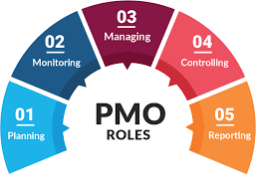
What does a PMO do ?
Support and follow-up function:
Consolidates project information to support decision making.
Disseminates and maintains PA policies and methodologies in the organization.
Report consolidated information to senior management.
Contributes to the implementation of the business strategy.
Serves as an agent of training and change.

Slide 18
Types of PMOs
Let's analyze the various organizational forms that a PMO can assume

Slide 19
Types of PMO (PMBOK® Guide)
Types of PMOs
Support
Of control
directive
PMBOK is a registered mark of the Project Management Institute, Inc.

Slide 20
Types of PMO (PMBOK ® Guide)
Support
They play an advisory role for projects.
They provide templates, best practices, training, access to information, and lessons learned from other projects.
They serve as a project repository.
This PMO exercises a reduced degree of control.
PMBOK is a registered mark of the Project Management Institute, Inc.

Slide 21
Types of PMO (PMBOK ® Guide)
Of control
They provide support and enforce compliance through different means.
This compliance may involve the adoption of project management frameworks or methodologies through specific templates, forms and tools, or compliance in terms of governance.
This PMO exercises a moderate degree of control.
PMBOK is a registered mark of the Project Management Institute, Inc.

Slide 22
Types of PMO (PMBOK Guide)
directive
The directing PMOs exercise control of the projects assuming their own direction.
This PMO exercises a high degree of control.

Slide 23
Types of PMO (Casey & Peck, 2001)
Types of PMOs
Weather Station
Control tower
Resource Pool
Casey, W. & Peck, W. (2001). choosing the right PMO setup . Retrieved from www.elg.net/articles/choosing-right-pmo-setup/

Slide 24
Types of PMO (Casey & Peck, 2001)
Weather Station
It addresses the need for executives in organizations to know what is happening with projects, through the generation of performance reports and events, without influencing the direction of the project.

Slide 25
Types of PMO (Casey & Peck, 2001)
control tower
It makes possible the improvement in project management.
Establishes, reinforces and improves standards for project management, develops methodologies and procedures to follow the standards, training and qualification.
It addresses the need to improve project management in organizations with training problems, methodologies, non-application or documentation of lessons learned, non-standardized use of tools and systems.

Slide 26
Types of PMO (Casey & Peck, 2001)
resource pool
It addresses the problem of organizations suffering from a lack of qualified personnel as project managers, through the availability of an inventory of qualified project management resources.
The management of the PMO is evaluated according to the performance of this pool of resources.

Slide 27
Types of PMO (Gerard Hill, 2014)
Types of PMOs
Project Office
Center of Excellence
Advanced PMO
Standard PMO
Basic PMO
Hill, G. (2014). The Complete Project Management Office Handbook (3rd Ed). Florida, USA: Taylor & Francis Group.

Slide 28
Types of PMO (Gerard Hill, 2014)
Project Office
Its fundamental objective is to produce the project deliverables according to the schedule and the budget, guaranteeing the good use of the resources.
Applies effective practices for the performance and supervision of projects, and when possible applies standard life cycle processes.
One or more projects
a project manager

Slide 29
Types of PMO (Gerard Hill, 2014)
Basic
It seeks a standard methodology for project management, guaranteeing its repeatability and its application in all projects, regardless of their nature.
Introduces critical processes and project management practices:
Identifies and develops critical processes.
Manage the use of critical processes in interlocking projects.
Identify best practices.
multiple projects
Multiple project managers
A program manager
Part-time staff for the PMO

Slide 30
Types of PMO (Gerard Hill, 2014)
Standard
It guarantees the development of capacities and infrastructure for good governance and support for projects, ensuring a stable climate for their management.
Establishes and monitors the use of a complete project management methodology:
Provides complete coverage of the project life cycle.
Integrates technical processes.
Develops the methodology for training project team members.
multiple projects
Multiple project managers
Multiple program directors
Staff with full dedication to the PMO

Slide 31
Types of PMO (Gerard Hill, 2014)
Advanced
Applies specialized skills and processes for project management, seeking to achieve project objectives.
Improve the content of the comprehensive methodology and monitor its use:
Integrates business processes
Optimizes automated tool alignment
Facilitates the use of the methodology in high-value business units.
multiple projects
Multiple project managers
Multiple program directors
PMO
Staff with full dedication for the technical and support functions of the PMO

Slide 32
Types of PMO (Gerard Hill, 2014)
Center of Excellence
Ensures a culture of continuous improvement regarding project management practices, and coordinates interactions with functional areas of the company to achieve strategic business objectives.
Carry out continuous analysis of the project management methodology:
Examines variations of project management processes across business units
Evaluates the use of the methodology, guaranteeing the continuous improvement of the process.
multiple projects
Multiple project managers
Multiple program directors
PMO
Staff with full dedication to the technical functions of the PMO
PMO support staff throughout the organization

Slide 33
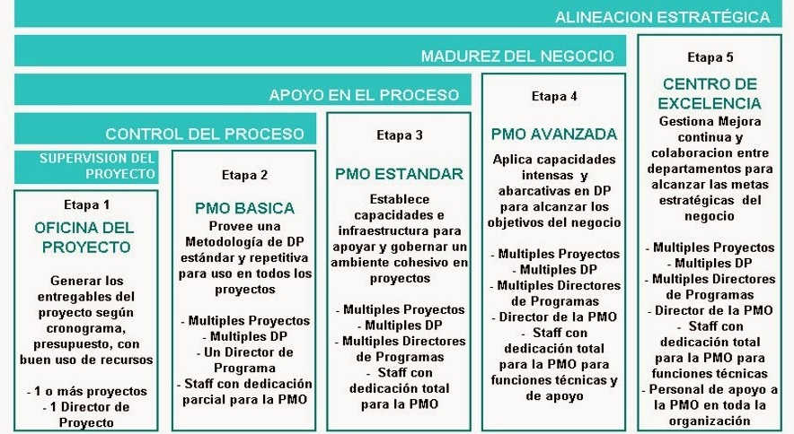
Types of PMO (Gerard Hill, 2014)
Boggi , C. (2011). Experience in the Implementation of the Project Management Office

Slide 34
Master in Project Management
Planning and Strategic Analysis of the Company
Presentation – Week 3: Strategic Assurance ( PMO )

